Slide 1
Economics Project 1
MAGGI STALLS
Group - 9

Slide 2
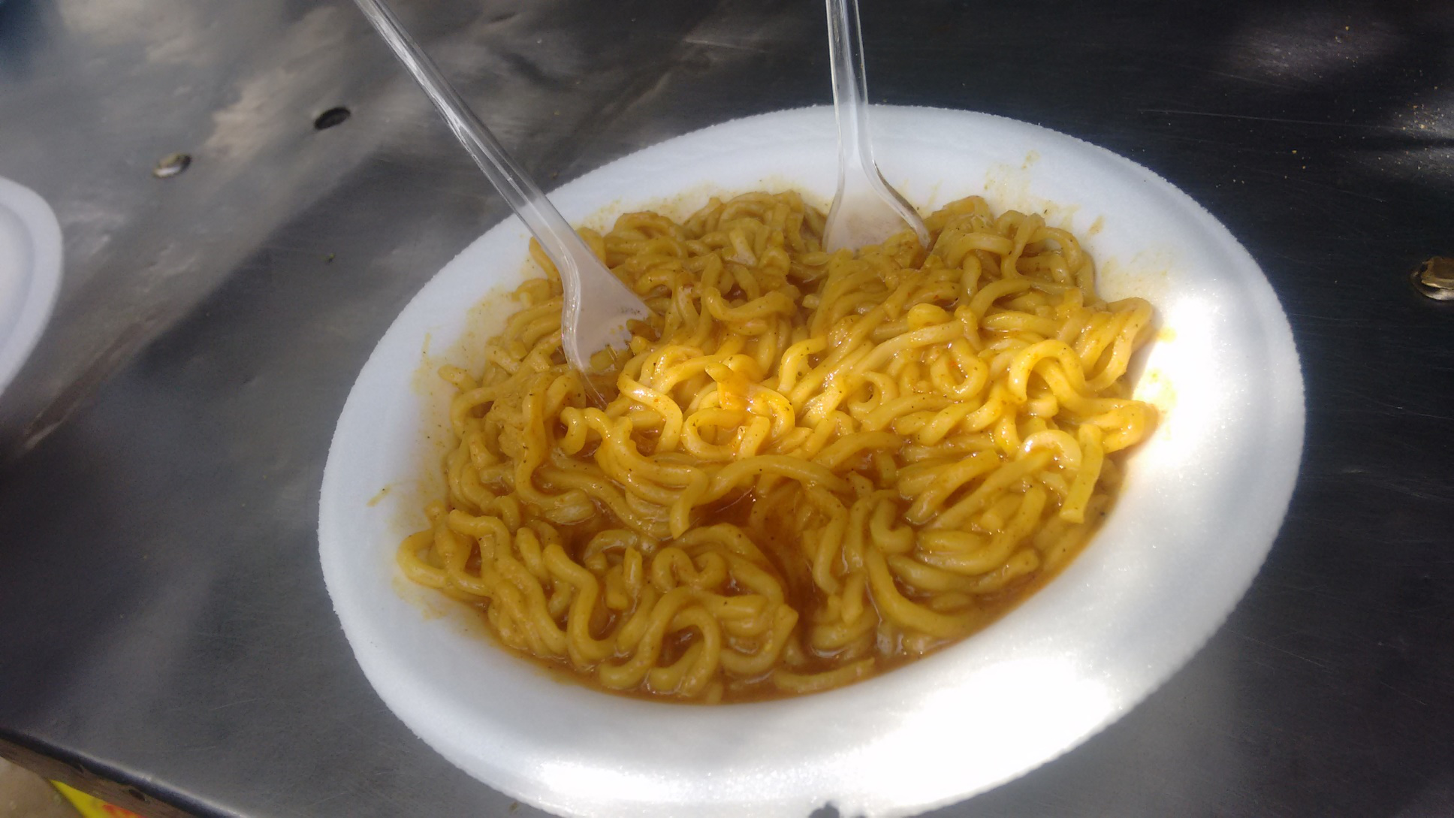

Slide 3
INTRODUCTION -
Maggi stalls are a huge rage nowadays. Because of the popularity of the ready to make ramen- maggi, there has been an increase in the no. of stalls all over Ahmedabad and other cities.
For our project we are considering the maggi stalls nearby the university area.
Maggi is an international brand of seasonings, instant soups, and noodles that originated in Switzerland.
Most of the stalls here have been since 10 years and some have been opened recently. We have surveyed 4 stalls among them.

Slide 4
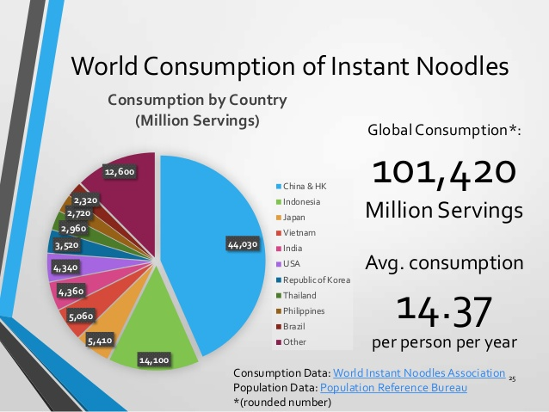
In India alone we consume 12,600 million servings of instant noodles.
The average consumption is 14.37 per year.

Slide 5
Why do people prefer packet noodles ??
21% - easier to purchase
19% - more delicious
17% - varieties in flavours
15% - faster to cook
15% - longer storing periods
12% - cheaper
1% - others

Slide 6
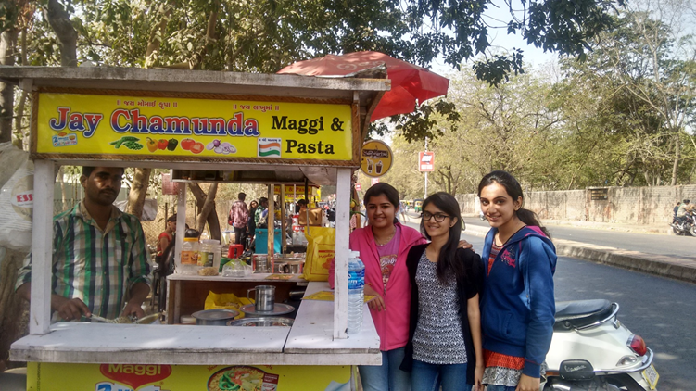
Maggi Stalls near University Road

Slide 7
MOTIVATION BEHIND THIS BUSINESS!!
We took reviews from four stalls ,
Stall 1 – The owner got the idea of maggi because he had an insight about the flavor and the fact that growing popularity of maggi would be advantageous over the existing sandwich stall. They started about 12 years ago.
Stall-2- This owner had a job before but he saw that maggie stalls were a huge thing now a days, people were all about maggi so he thought that having a maggi stall would be financially beneficiary to him. He started about a year ago.
Stall-3 – The stall owner had a coffee stall before the maggi stall and had personal preference of maggi and so decided that a maggi stall would do him good. He started about 10 years ago.
Stall-4 –Two people had an idea of starting the maggi and they previously owned frankie stall. They started from 2003.

Slide 8
HOW THE LOCATION WAS AN ADVANTAGE --
Why near university road ?
All of these people(the four stalls) had the same thought of selecting this place for the stall as it was the university area which has around 7-8 colleges, 2 schools and this area being one of the highly populated areas, they chose this place.
Not only youth but even families visit this place. So they found it the most suitable one.

Slide 9
INGREDIENTS USED :
Major ingredient is the maggi noodles itself, and the rest is just water and the spices they use .
There are around 40 different flavors. Most of the items on the stall are common among them.However some of them do experiment with different types of ingredients like chocolates, Veg Cheese Makai Tadka, lasagna maggi , Mexican maggi.

Slide 10
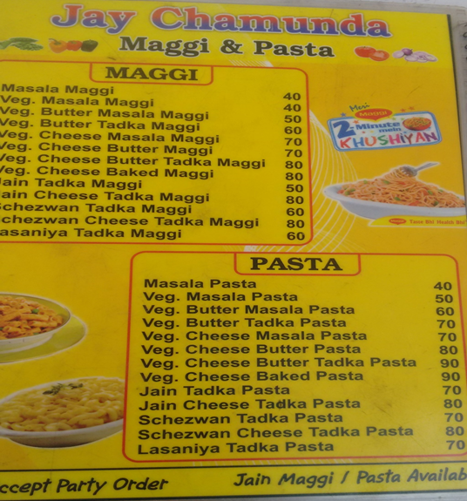
Types of maggi
Sold in stalls

Slide 11
ADVERTISEMENTS
Stall-4 advertises through radio sometimes. However, the stall-2 started newly he said he really didn’t need advertising because already the maggi business was booming.
FUTURE PLANS OR ANY BRANCHES
Stall 1 Has another stall of sandwiches
Stall 2 Does not have any branches
Stall 3 Has a coffee stall
Stall 4 Has a frankie stall

Slide 12
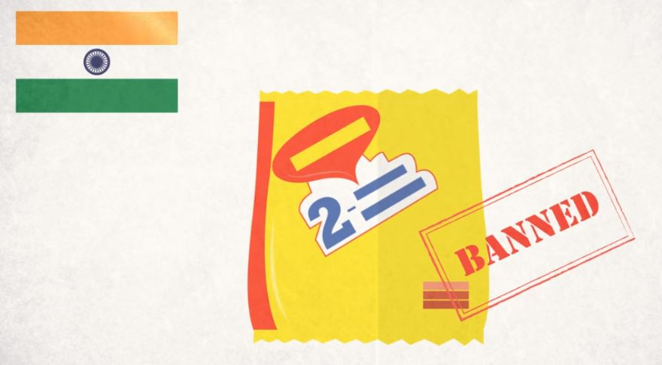
The Maggi ban

Slide 13
How the ban affected the maggi stalls
Gujarat food and drug control authority (FDCA) banned the sales of maggi in the first week of june after lead and msg levels in the product were above the permissible levels. This lead to all the maggi stall owners to abandon the usage of maggi and switch to other ramen noodles like yippee and later to wai - wai which actually became pretty popular among people but not as popular as maggi itself .

Slide 14
But some of the stalls couldn’t make the switch so easily as they did not get the suppliers to supply yippee noodles that fast because with maggi gone the demand of yippee suddenly rose and couldn’t be met easily. So these stalls had to suffer a loss and had to stay shut for about a month and finally had to make a switch to wai wai.
With wai-wai the demand went down from 150 a day to 90-100 per day hence their profits per day.

Slide 15
Return of maggi
The nation wide ban on maggi was lifted by the bombay high court on August 13.
But it wasn’t available in the market until after a week or so. Finally when maggi came back in the market the stalls which had previously adapted to wai wai again dropped the wai wai and switched back to maggi . The return of maggi back to the stalls noted an increase of 30% in sales as compared to wai wai.
Now, maggi is deemed as safe and is used as popularly as ever in both households and on the stalls.

Slide 16
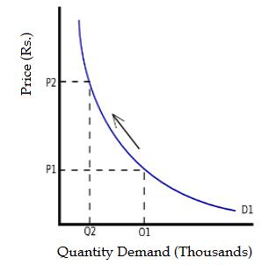
LAW OF DEMAND
It is normally depicted as an inverse relation of quantity demanded of and price ;the higher the price of the product, the less the consumer will demand.
In our case, also the relation between quantity demanded and price is similar to this curve.

Slide 17
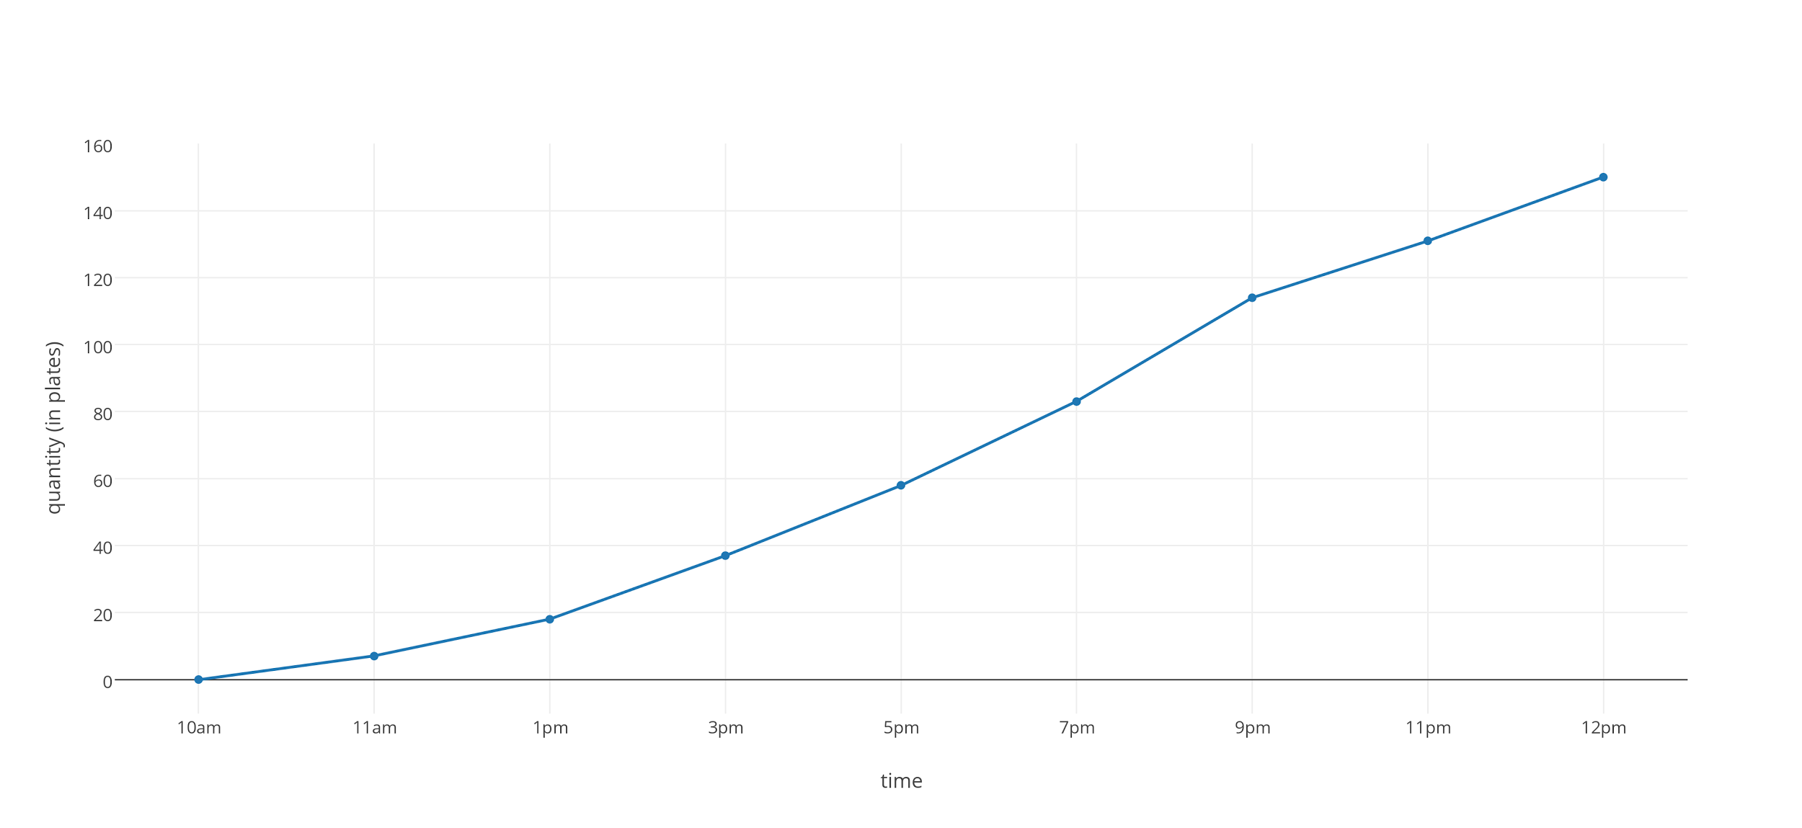
DEMAND ANALYSIS (PER HOUR):

Slide 18
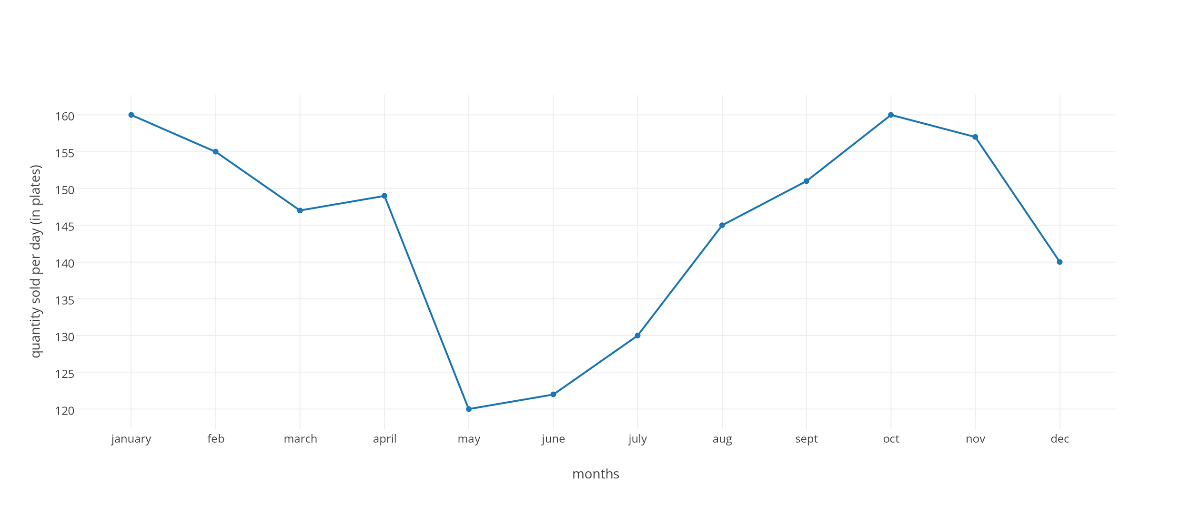
DEMAND ANALYSIS (PER MONTH) :

Slide 19
FACTORS AFFECTING DEMAND OF MAGGI IN STALLS:
1.Price of relative goods: Demand for maggi is also influenced by the change in price of relative goods.Relative goods includes :
1) Substitute
2) Complimentary
In our case there can be no substitute and complimentary of maggi.

Slide 20
RELATED GOODS AND QUANTITY
Stall 1 - Did not increase any prices because changing the menu would cost him loss.
Stall 2 - Had increased prices with the increase in the price of the related goods like tomatoes capsicum and onions from 30 rupees to 40 rupees keeping the quantity same.
Stall 3 - The same price since last 4 years.
Stall 4 - Increases the prices of Maggi only if the price of maggi(packet) increases.

Slide 21
2. INCOME OF THE CONSUMER
There is a direct relationship between income of consumer and demand. In our case majority consumers are the students . Thus they do not have an income instead they have their pocket money.
3. TASTE AND PREFERENCES
Taste and preferences of the consumers also influence the demand to greater extent. The regular customers prefer fixed stalls but new customers try new stalls after the recommendation from their friends.

Slide 22
4. GOVERNMENT POLICIES :
As the study shows, there was a steep reduction in the demand of Maggi as before the maggi ban ,maggi sort of had a monopoly in the ready to make food market . But on june 4, 2015 , the Gujarat FDA, banned the noodles for 30 days after 27 out 39 samples were detected with objectionable level of metallic lead and msg.
5. TIME
Time is an important factor that affects the demand of Maggi e.g. the demand increases during the fest going in the nearby colleges, during winters and the beginning of the semesters. There is decrease in demand the vacations.

Slide 23
6. AGE GROUP OF THE POPULATION
This product is mostly liked by age group of teenagers and also adults so the age groups are affecting the demand of the product and by the increase in the population, the demand of the product also increases.

Slide 24
SHIFT IN DEMAND CURVES
Shift in demand curves refers to the change in demand due to change in factors other than price.
Shift can be of 2 types-
1) Upward shift
2) Downward shift

Slide 25
Upward Shift
In upward shift price being constant, the demand for maggi increases, due to change in other factors e.g. Increase in income.
If there’s an increase in the pocket money of consumers in the future, then there’s a possibility that the consumer will have more number of plates in a week.
Another factor : Time
Also at the time of festive seasons near the colleges the demand increases.

Slide 26
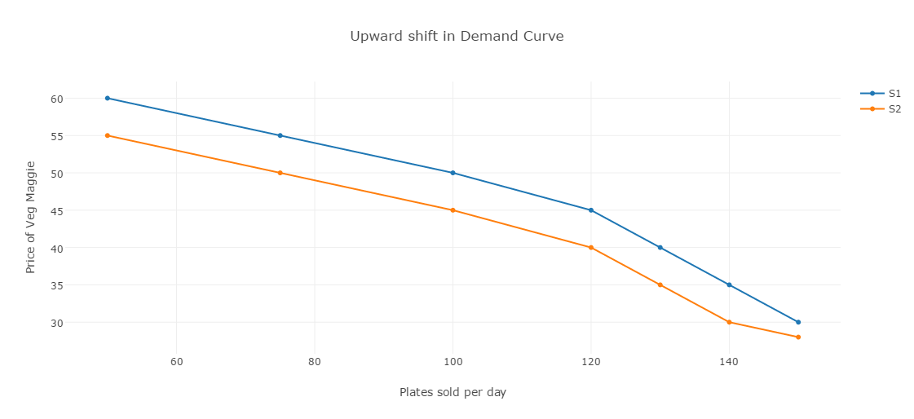
Upward shift graph
Factor : Income
S1 = when income(pocket money) is 3000
S2 = when income(pocket money) is 2000

Slide 27
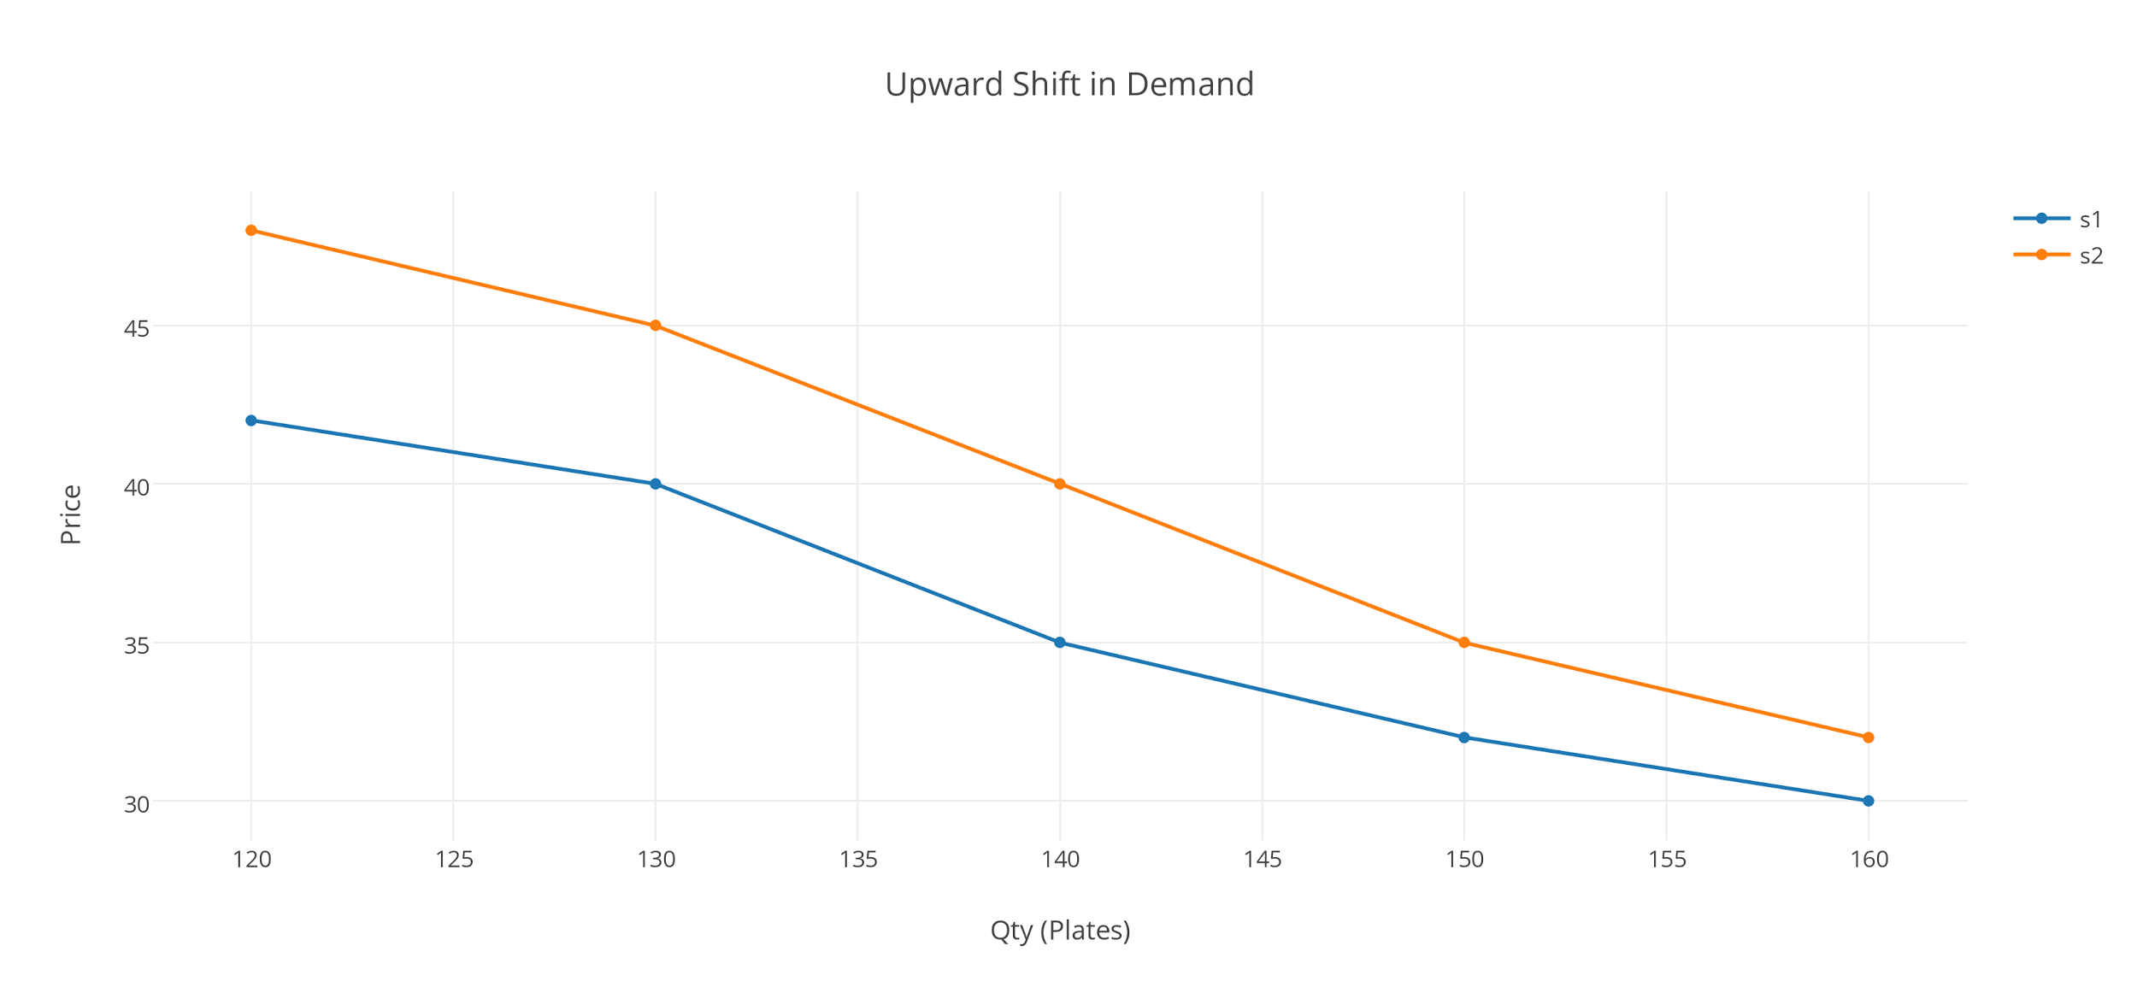
Upward shift graph
Factor : Time (Festivals )
S1 = In normal days
S2 = In Festival days

Slide 28
Downward Shift
In downward shift price being constant, the demand for maggi decreases, due to change in other factors.
Eg. the demand for maggi reduces when people found that there was metallic led found in few samples of maggi.
CHANGE IN DEMAND
During the vacation period there is a 30% - 50% decrease in the demand as the stalls are surrounded by colleges all around so during the vacation period the demand of maggi decreases.

Slide 29
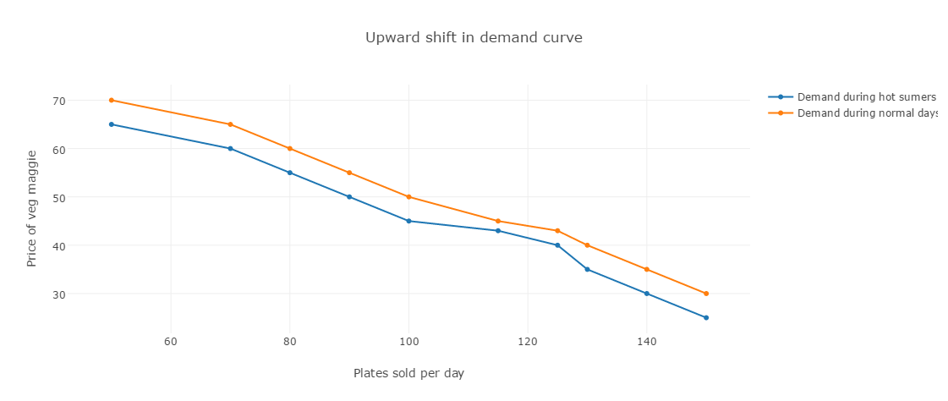
Plot of Downward Shift
Factor : Time (Vacation)
Downward Shift in Demand

Slide 30
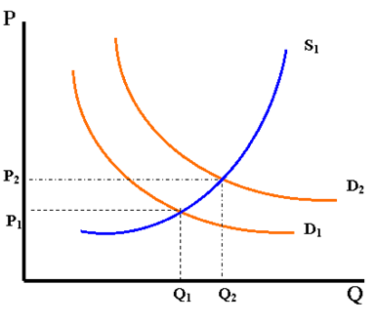
Supply Analysis
Law of supply :
It states that if the price of a product increases, quantity supply will increase as the supplier will be willing to supply more to earn more profit. In our case the price of maggi plates is j simultaneously by all stalls and quantity supplied by each stall increases to a limit as they’ll earn more profit.

Slide 31
Factors affecting supply
1. PRICE:
The price is positively related with quantity supplied for maggi, in short run if there is an increase in the price of maggi, the producers will be willing to produce more of the product.
2. NUMBER OF CONSUMER:
In the case of maggi there are large number of consumer, as a result the supplier are willing to supply more to cater the needs for the large number of customer.

Slide 32
3. PRICE OF INPUTS:
Includes gas cylinder, maintenance of the stall , other food products etc. if there is no scarcity in the supply of these factors so the cost for these factors will reduce as a result the producer is willing to supply more products at same price.

Slide 33
Shift in supply curves
Shift in supply curve means change in quantity supplied due to others factors while price remains the same.
In our case there will be downward shift in supply curve.

Slide 34
Downward Shift in supply curve
Here, the price keeping constant other factors are to be taken in consideration.
Let us take the fact of maggi-ban. When there was objectionable amount of lead found in maggi, there was a decrease in supply of maggi and the stall owners opted for using different noodles like wai-wai etc, no matter price remaining same.

Slide 35
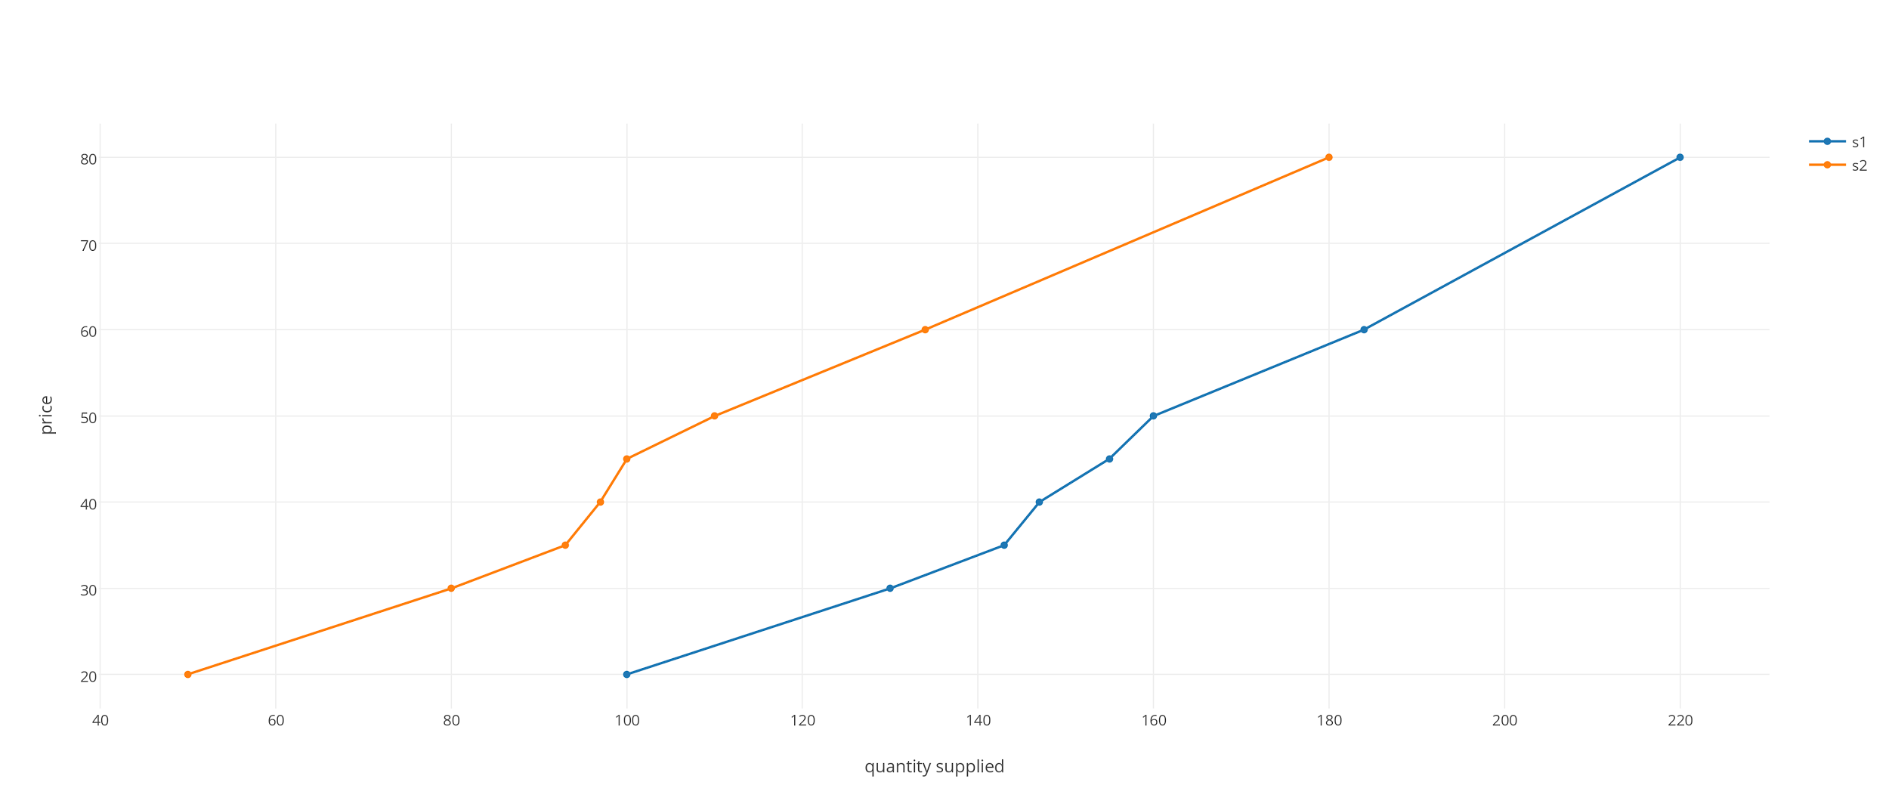
Plot of Downward Shift
S1: supply of maggi when there was no ban
S2 : supply of maggi when there was ban

Slide 36
Elasticity Analysis
ELASTICITY OF DEMAND:
The elasticity of demand for a commodity is the rate at which quantity changes as the price changes.
Price Elasticity = %Change in Qty Demand
_______________________
%Change in Price

Slide 37
DETERMINANTS OF ELASTICITY
AVAILABILITY OF SUBSTITUTES:
In the case of maggi , substitutes are not available in the market .So even if there is a increase in the price of maggi, the consumers will not shift their intake as much from maggi.
Maggi is that product which is meant for the youngsters. Even in the long run the demand is inelastic because even in the long run if there is a increase in price of maggi the hard core maggi consumer will not shift their preference. And in short run the demand is inelastic.

Slide 38
Conclusion
These were the analysis of our product maggi.
* Finally we found that the stalls have a same pattern of increase and decrease in demand of Maggi.
* Also the increase in prices of different maggi varieties is the same in all the stalls.
* In short the increase in demand,supply,prices etc is similar in all the stalls.
* On doing the analysis we found that it is monopolistic market.

Slide 39
References -
http://www.thehindu.com/news/national/latest-developments-in-row-over-maggis-food-safety/article7271044.ece
https://www.quora.com/Why-was-Maggi-banned
http://indianexpress.com/article/india/india-news-india/gujarat-govt-lifts-ban-on-sale-of-maggi/

Slide 40
Market Analysis

Slide 41
Types Of Market:
Perfectly Competitive Market
Monopoly Market
Monopolistic Market
Oligopoly Market
Here, Perfectly Competitive and Monopoly Markets are theoretical markets which are not possible in real market.
This is because Perfectly Competitive market has 100% competition and Monopoly market has 0% market.

Slide 42
Our Analysis
We analysed our product, and then we compared it with both oligopoly and monopolistic market.
Monopolistic Market
Monopolistic market is where the number of consumers and producers are more.
There is completely free entry and exit.
Products differentiate from producer to producer.
They advertise their product.
Many producers for one consumer(Consumer Monopoly)(Price takers)

Slide 43
Oligopoly Market
Competition less than Monopolistic market.
They keep an eye on their competitors because there are less number of producers and if the other person sells it in lower price then he will have less customers and thus he would be in a loss.
One small mistake can lead all the consumers to buy from their competitors.

Slide 44
Our Maggi Stall Market
We analyzed different stalls ,
We found out that some of the stall owners had joined around 10 years ago and some left their other jobs as they thought this would bring them more profit and have joined it some months ago. This shows that there is completely free entry and exit.
In our case, we analysed the maggie stalls around commerce six roads. We found minimum 30 stalls. Also every stall had many customers. Thus it shows that this market has many producers and customers.

Slide 45
Our Maggie stalls
3. Mostly, the variety of products sold were same. But taste and preferences mattered hence there is product differentiation. Also,there was at least one product that was different in each stall. Thus, there is product differentiation. For one consumer,there are many producers.Thus, there is consumer Monopoly.
4.Producers do not have control over price of the product.They are price takers.
5. Also they keep eye on their competitors.All the stall owners increases or decreases the price simultaneously.

Slide 46
Our Market
Taking all the points in consideration:
Maggie stalls show maximum resemblance to Monopolistic Market.(Also shows 1 or 2 characteristics of Oligopoly Market)
Thus, our maggi stall market is Monopolistic (Basically a mixture of Monopolistic and Oligopoly Market).

Slide 47
Thank You
Rupam Jogal (1401003)
Rushita Thakkar (1401004)
Charmi Kalani (1401067)
Ishika Agarwal (1401069)
Twinkle Vaghela (1401106)
Nivedita Rao (1401100)
Himani Patel (1401111)
Honey Gadhiya (1401112)

